Slide 1
Embedding EDI into organisational culture
Lindsay Games, Sport England
Trixie Marchant, UK Sport
SGA Annual Conference – Cascading Good Governance
23 November 2022
In partnership with

Slide 2
The EDI Challenge
Athletes: First time, more women than men in Team GB in Tokyo – but several sports with very little or no ethnically diverse funded athletes
Board diversity data of UK Sport and Sport England funded bodies (2020)
44% female/56% male (2018 – 40%/60%)
13% declared disability (2018 – 5%)
8% Black Minority Ethnic (2018 – 5%) and 5% 'other' ethnicity
4.5% LGBT+ (2018 – 3%)
Improvements but still not reflective of UK society

Slide 3
EDI organisational and governance framework in UK Sport
UK Sport Board
Board EDI Champion
Senior Leadership Team
Director Diversity Champions
EDI Working Group
Ensures momentum on delivery of EDI Strategy for High Performance System
Priority 1: More diverse athlete and talent workforce pathways
Priority 2: More diverse leadership in national and international sports bodies
Priority 3: Diversity and inclusion embedded across all UK Sport programmes
Priority 4: Driving with pace, ambition and accountability EDI within UK Sport → DIAP
Anti-Racism Group
Employee Resource Groups
All Staff
TRARIIS Implementation Group

Slide 4
Tackling Racism and Racial Inequality in Sport (TRARIIS review)
Findings
Everyday acts of covert and overt racist practices, attitudes and behaviours are present in sporting activities, structures, administration and leadership across the UK. The stories present a pattern of casual, stealthy and blatant racism.

Slide 5
Sports Councils’ Commitments to TRARIIS

Slide 6
Sport England – Embedding EDI practically
Uniting the Movement
Tackling inequalities
‘Intentionally Inclusive’
EDI Strategy
Our own DIAP

Slide 7
Old Standard
5 Pillars
DIAP v Framework
New Framework
How it works
Review of the Equality Standard for Sport
Policy
Self-reflection
Continuous improvement plan
Implementation
Review

Slide 8
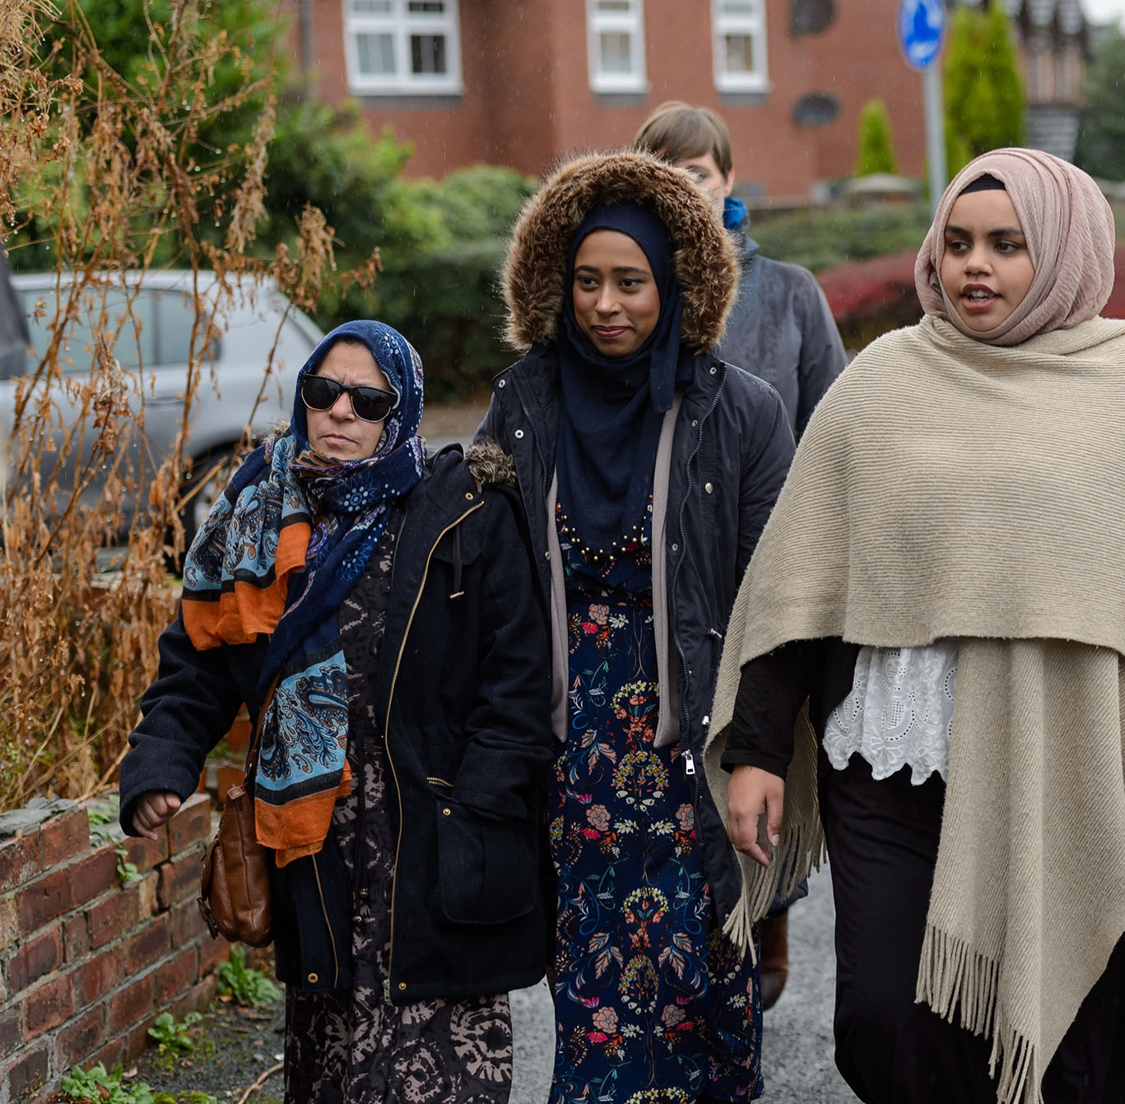
Leading for Renewal
Inclusion by design
EDI knowledge
Ongoing L&D
Considerations
Workforce diversity
Safe & neutral spaces
Communities of practice
Meaningful consultation
Talent pathways

Slide 9
Questions
In partnership with

Slide 10
Thank you
www.sportsgovernanceacademy.org
In partnership with

